Slide 1
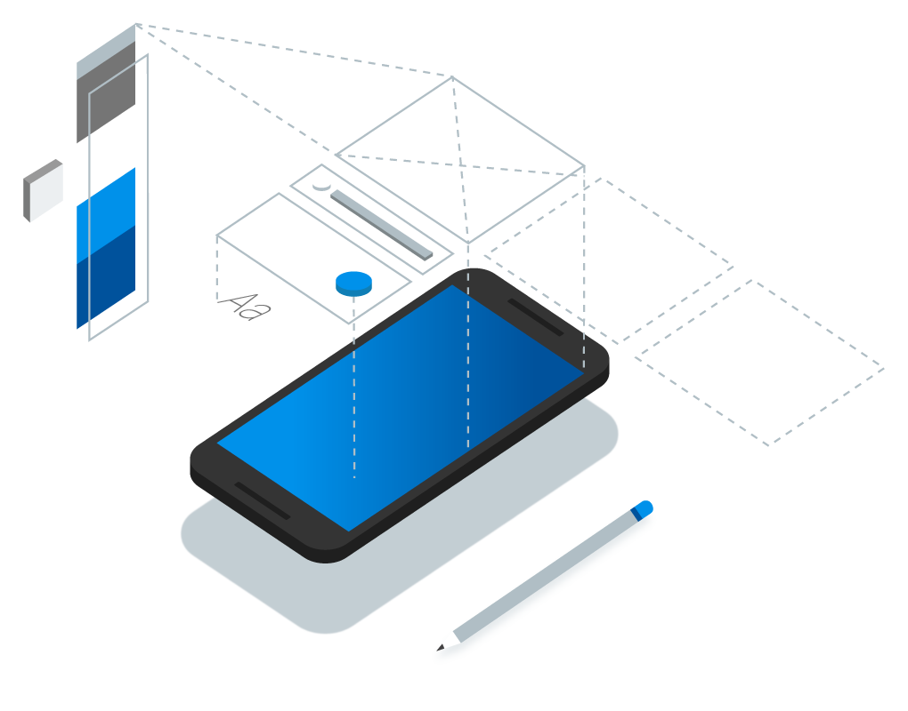

Developing Basic Flutter Apps
By Harsh Kumar

Slide 2
What’s for today?
Building First Widget
Creating Hello World App
Stateless & Stateful Widget
Using Buttons and List
Understanding Counter App

Slide 3


Building First Widget
Widget is the building block of the flutter UI.
Everything that we see on the screen, whether it is a simple “Text” or “Buttons” or “Screen Layouts” all are Widgets.

Slide 5
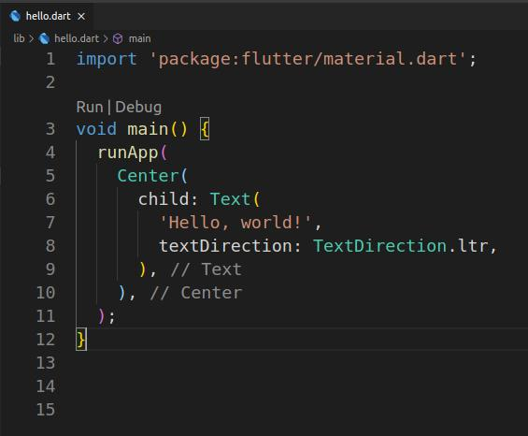

Slide 6

Creating Hello World App
We are going to make our first Hello world application.

Slide 7
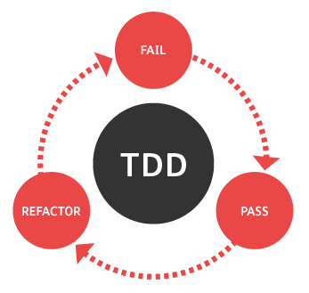
Stateless & Stateful Widget
The widget which contains the code for a single screen of the app can be just of two types-
Stateless
Stateful
Let’s discuss them

Slide 8

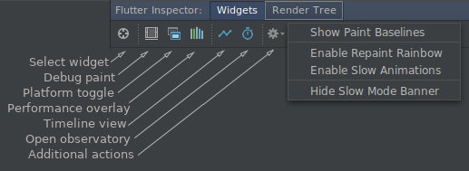

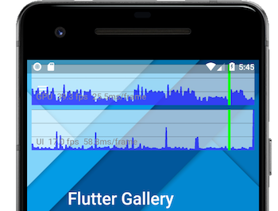
Stateless Widget
Stateless Widgets are immutable.
In simple words Stateless widget cannot change their state during runtime of the app,which means widgets cannot be redrawn while the apps in action.

Slide 9
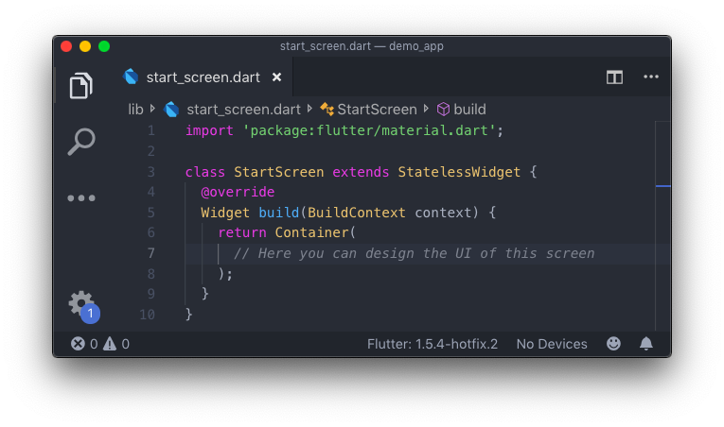

Slide 10
Stateful Widget
Stateful Widgets have a mutable state i.e. They can be drawn multiple times within its lifetime.
These widget can change their state multiple times while runtime of the application.

Slide 11
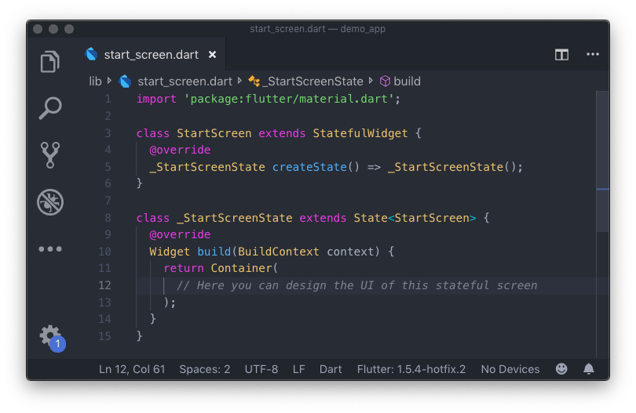

Slide 12
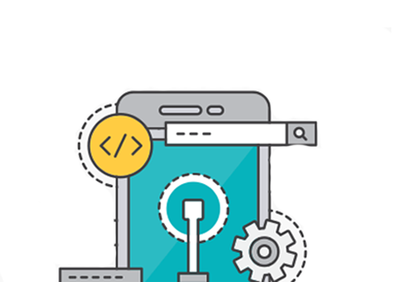
Using Buttons and lists
We have many types of button widgets in Flutter Material Library.
Some of them are-
RaisedButton
ButtonBar
DropdownButton
FlatButton
IconButton

Slide 13



Understanding Counter App
Let's see how the default counter app works.

Slide 14

Flutter Done Right?
IN.
Any Questions?

Slide 15

Thanks!
harshkumar9.in@gmail.com
Github: https://github.com/harsh-9in
Twitter: @harsh_9in

